Slide 1
Data Mining For Business CSCI E-96
Case 2: National City
Andrew Fabrizio
April 4, 2022

Slide 2
overview
Problem Statement
Dataset Characteristics
Models
Decision Tree
Logistic Regression
Top 100 Prospects

Slide 3
Problem Statement
Identify the top 100 customers most likely to accept an offer from a list of prospective customers.
Construct a customer propensity model that can be scaled further if authorized.

Slide 4
Dataset Characteristics
Past Outcome!!!!
89.26% success in predicting accepted offers!
Job
Positive correlation for students, retired, unemployed
Negative correlation for blue-collar, services, housemaid, entrepreneur
Education
More educated = more likely to accept

Slide 5
Models: ^{Comparison}
KNN
55% Accuracy on training data
Optimized 5 nearest neighbors
Decision Tree
72% Accuracy on test data
2-3 decision points
Logistic Regression
76% Accuracy on test data

Slide 6
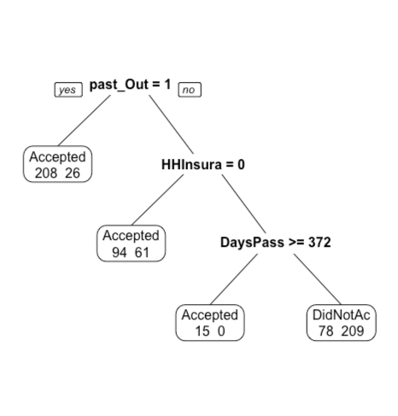
Models: ^{Decision Tree}
72% Accuracy on test data
Ridiculously Simple
DaysPass seems odd, but little impact
Found in Decision_Tree_Model.R

Slide 7
Models: ^{Logistic Regression}
Relevant Variables
Past outcome
carModel
Education
Marital Status (single)
annualDonations
Job
HHInsurance
CarLoan
Gender (F)
76% Accuracy
A couple weird variables
Found in Logistic_Regression_Model.R

Slide 8
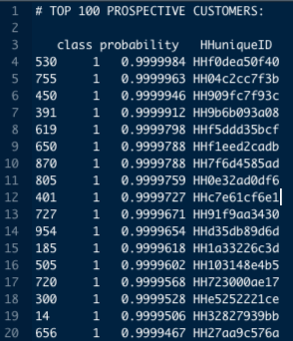
TOP 100 Customer Prospects
Listed in top_100_customers.txt
Range from five 9’s to 85% probability
Way more accurate than necessary
Desired probability would likely be determined by:
Revenue x probability > cost

Slide 9
Conclusion

